Slide 1
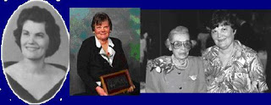
Margaret A. Newman’s Theory of Health as Expanding Consciousness
Susan Clough
Chenal Roberts
Liz Saltigerald
Theory Foundations for Advanced Nursing
Section 104, Fall 2021

Slide 2
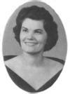
Dr. Margaret A. Newman was born on October 10, 1933. After graduating with her B.A. from Baylor, she returned home to care for her ailing mother, who had been diagnosed with ALS, Amyotrophic Lateral Sclerosis (Lou Gehrig's disease). During this time, she realized she wanted to go back to school to start a career in nursing.
While caring for her mother she learned that one can be healthy even in the face of disease. From there she started her journey to advancing nursing theory, education, research, and practice. Though she retired from teaching in 1999, she remained highly invested in education, research and practice through presentations and publications.
Dr. Margaret Newman passed December 18, 2018, at the age of 85.
Notes:
Dr Margaret Newman, was born October 10th, 1933 in Memphis TN. At the age of 21, she returned home after getting her BA from Baylor, to care for her mother who had been diagnosed with ALS. It was during this experience that Margaret realized “each day is precious and that the time of one’s life is contained the present”. She came to realize that just because one has a disease does not mean a person is unhealthy. It was through this experience with her mother that Margaret felt a calling to Nursing

Slide 3
EDUCATION
Bachelors- University of Tennessee 1962
Doctorate – NYU 1971
WORK
Joint director of Nursing
Nurse Theorist – University of Minnesota 1984 – 1996
HONORS AND ACKNOWLEDGEMENTS
Fellow in the American Academy of Nursing
E. Louise Grant Award for Nursing Excellence from Univ. of Minnesota
Masters – University of California 1964
Asst. Professor of nursing – University of Tenn.
Professor in Charge of Grad Study in Nursing – Penn State
Outstanding Alumni by Univ. of Tenn. And NYU
Distinguished Scholar of Nursing Award from NYU
Founders Award for Excellence in Nursing Research from Sigma Theta Tau International
Bachelors in Arts - Baylor University
Civilian consultant to the U.S. Surgeon General for Nursing Research

Slide 4
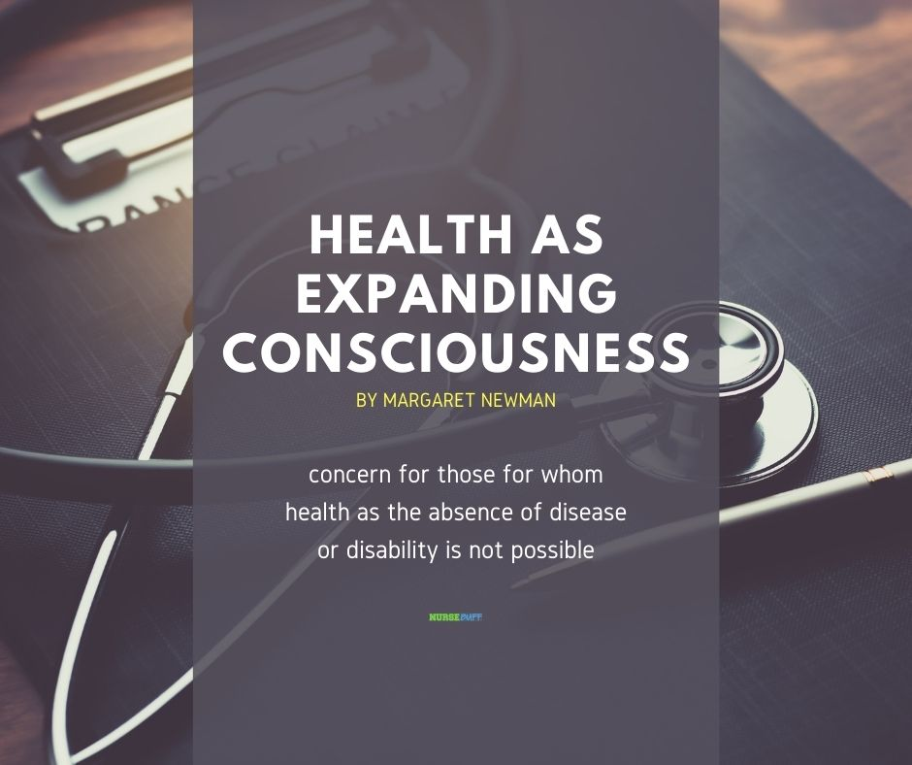
I don’t like controlling, manipulating people. I don’t like deceiving, withholding, or treating people as subjects or objects. I don’t like acting as an objective non-person. I do like interacting authentically, listening, understanding, communicating freely. I do like knowing and expressing myself in mutual relationships. – Margaret Newman (1990)
Notes:
Health as Expanding Consciousness is a grand nursing theory that can be applied to all areas of nursing practice. Dr. Newman's believed that people in any situation can expand their consciousness, take part in the universal process of finding greater meaning in life and interconnect with other people and the world. She defines health as the growth of consciousness and the nurse's role as one of focusing on the wholeness of people. Disease is considered not as an independent entity but a part of the pattern of the interaction between people and their environments.

Slide 5
The initial idea for Newman’s Health as Expanding Consciousness Theory came together as a result of an invitation to speak at a conference on nursing in 1978.
Other theorists that
influenced her work:
Rogers’ Theory of Unitary Human Beings. It was stimulated by concern for those for whom the absence of disease or disability is not possible.
Bentov’s concept of the evolution of consciousness,
Young’s Theory of Process
Bohm’s Theory of Implicate
This grand theory of nursing claims that every person in every situation, regardless of how disordered and hopeless it may seem, is part of the universal process of expanding consciousness, which is a process of becoming more of oneself, finding greater meaning in life, and of reaching new dimensions of connectedness with other people and the world.

Slide 6
HEC and nursing metaparadigms
Health
“Health and illness are synthesized as health - the fusion on one state of being (disease) with its opposite (non-disease) results in what can be regarded as health”.
Nursing
Nursing is “caring in the human health experience”.
Nursing is seen as a partnership between the nurse and client, in which both grow, in the “sense of higher levels of consciousness”
Human
“The human is unitary, that is, it cannot be divided into parts, and is inseparable from the larger unitary field”
“Persons as individuals, and human beings as a species are identified by their patterns of consciousness.”
“The person does not possess consciousness-the person is consciousness”.
Persons are “centers of consciousness” within an overall pattern of expanding consciousness”
Environment
Environment is described as a “universe of open systems”

Slide 7
Newman’s theory makes six assumptions
Health is an expansion of the consciousness
Health encompasses conditions heretofore described as illness, or, in medical terms, pathology
The pattern of the individual patient that eventually manifests itself as pathology is primary and exists prior to structural or functional changes
Removal of the pathology will not change the pattern of the individual patient.
If becoming ill is the only way an individual patient’s pattern can manifest itself, then that is health for that individual patient.
These pathological conditions can be considered a manifestation of the total pattern of the individual patient.
Notes:
The theory states that every being in every situation, no matter how chaotic and despondent it may seem, is part if the universal process of expanding consciousness– a process of becoming more of oneself, of finding greater meaning in life, and of reaching new dimensions of connectedness with other people and the world.

Slide 8
“ One does not practice nursing using the theory, but rather the theory becomes a way of being with the client -- a way of offering clients an opportunity to know and be known and to find their way” – Margaret Newman (2005)
According to Newman, nursing is the process of recognizing the patient in relation to the environment, and it is the process of the understanding of consciousness. The nurse helps patients understand how to use the power they have within in order to develop a higher level of consciousness. Therefore, it helps to realize the process of disease, its recovery, and its prevention. Nursing is seen as a partnership between the nurse and patient, and both grow in the sense of higher levels of consciousness.

Slide 9
Understanding Margaret Newman’s Theory

Slide 10
Application to advanced practice nursing
Expanding Consciousness
Time and Presence
Resonating With the Whole
Attention to Pattern and Meaning
Insights Occurring as Choice Points of Action Potential
Mutuality of the Nurse-Patient Relationship
Notes:
The capacity of the system to interact with the environment
Be truly present to patients in a meaningful and whole manner with the here and now
To resonate with patients and form open relationships, nurses must let go of personal judgments about and transcend cultural beliefs and values
Each person displays a distinct pattern, which is continuously unfolding and evolving and the person interacts with the environment.
A system changes in an organized fashion until some disruption occurs, and the system moves in a apparently random, chaotic, disorderly way until at some point it chooses to move into a higher level of organization
Being with the patient rather than doing for the patient. It is caring in its deepest, most respectful sense with a focus on what is important to the patient.

Slide 11
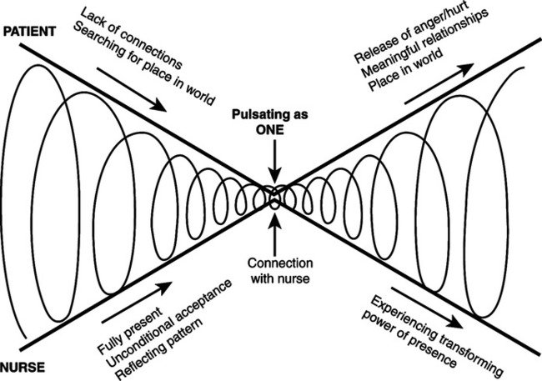
Notes:
Nurse and patient coming together and moving apart in process recognition, insight, and transformation

Slide 12
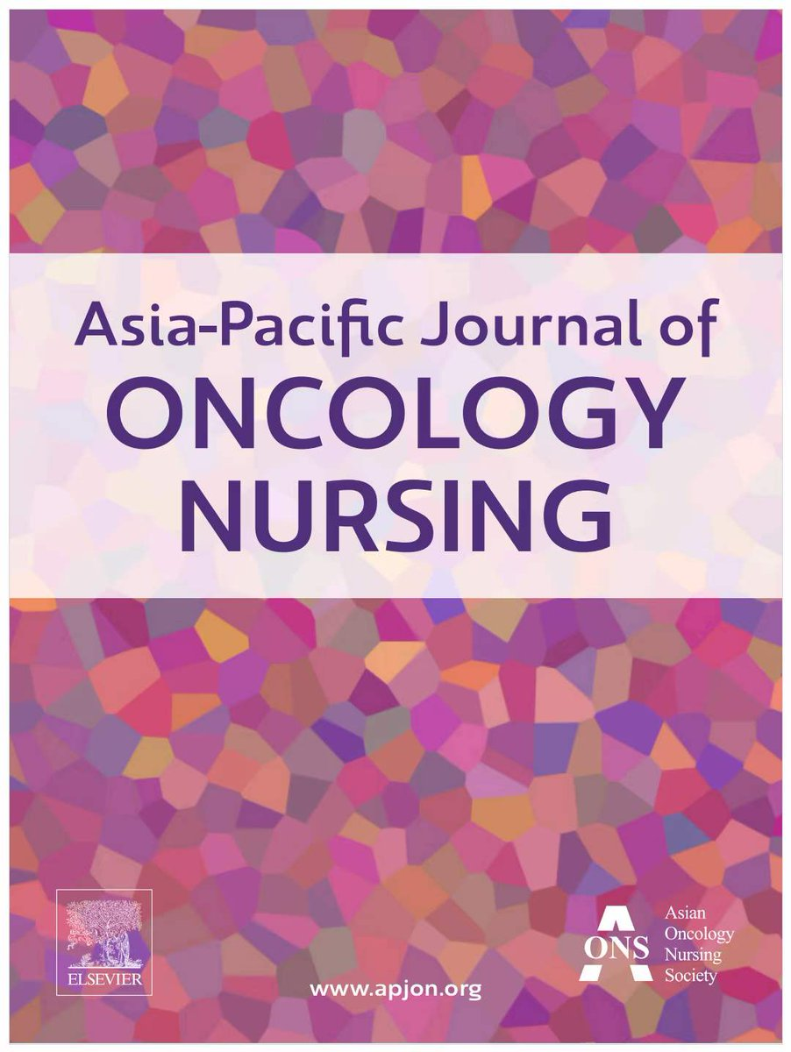
“A patient with cancer and her family in caring partnership based on Margaret Newman's theory of health as expanding consciousness”
A study was conducted in Kanagawa, Japan to practice the caring partnership with a patient diagnosed with cancer and her family after being informed by the medical team that treatments were not working and to delineate the process of their relational changes within the caring partnership (Fujiwara 2017).

Slide 13
Overview of study
Case study focuses on a patient in her 50’s diagnosed with Stage IV cancer.
This patient was hospitalized alone and did not inform her family of her diagnosis.
Nurse researcher noticed that the patient was “closed off” and approached her by saying: “I want to enter into a partnership with you because I want to help you.”
Patient agreed to the partnership and agreed to the research design which was as follows:
Four dialog meetings lasting approximately 60 minutes in which Newman’s praxis protocol was utilized as a nursing intervention in a unitary perspective.
The first step was to invite the patient to “talk about meaningful relationships and events in your life.”
The second step was to share a diagram illustrating the patients life drawn by a researcher and to invite her family in sharing her story with each agreement
The third step was to have follow-up meetings.

Slide 14
Dialog meetings
Meeting Number One
The patient discussed her life story with the researcher. The patient began to realize her behavioral pattern of “not wanting to bother others” and her desire “not to worry her family with her cancer diagnosis”.
Meeting Number Two
During the second meeting, the patient’s husband and father joined.
Meeting Number Three
During the third meeting, the patient’s daughter joined.
The patient discussed how she has always been independent stemming from her belief that she “needs to take care of her younger brothers”.
Patient began to realize that she has always gone out of her way so as not to burden or bother others with her needs or problems
Patient’s daughter expressed her appreciation for the meetings as she had already noticed a change in her parents and their willingness to be open and honest with her.
The family acknowledged the value they have gained from this introspective experience.
Patient was able to verbalize her behavioral pattern of not being open and honest with her family as a way of not burdening them.
Patient’s father and husband acknowledged this pattern and agreed that they also needed to be more open and honest.
Patient began to realize that she needed to rely on others.

Slide 15
Final meeting and conclusion
During the family’s final meeting, the patient and her family expressed their gratitude and stated that they had “grown as a family throughout this experience”.
The patient stated that despite her terminal diagnosis she has “never felt better”.
The nurse researcher truly embodied Newman’s statement that the theory becomes “a way of being with the client—a way of offering clients an opportunity to know and be known and to find their way”,
The patient, through this experience, came to “see health not as the absence of disease, but as a process of becoming more of themselves, of finding greater meaning in their lives”, and was able to reach “new heights of connectedness with other people and the world” (Smith, 2020).

Slide 16
Strengths & Limitations
Strengths
Limitations
Newman’s theory can be applied in any setting
and
Can generate caring interventions
It’s abstract
Multidimensional
Qualitative
Little discussion on environment
Notes:
Strengths
1. It is applicable across the spectrum of nursing care situations.
2.
Limitations
-3 when we look at Dr Newman’s milestones, we can see that she was likely highly intelligent – from BSN to PhD within 9 years. Likely an abstract thinker as literature tells us that she saw patterns and often refers to this throughout her theory
4. Not explicitly defined but described as being the larger whole

Slide 17
summary
Margaret Newman’s Theory of Health as Expanding Consciousness asks nurses to focus on what is meaningful in their practice and in the lives of their patients. The focus of nursing practice is not on predetermined outcomes influenced by the health systems or on “fixing” the patient but allows the nurse to work in partnership with their patients to evaluate what is meaningful in his or her evolving experience of health. (Smith 2020).

Slide 18
REFERENCES:
Fujiwara, Y., Endo, E. (2017). A Patient with Cancer and her Family in Caring Partnership Based on Margaret Newman’s Theory of Health as Expanding Consciousness. Asia-Pacific Journal of Oncology Nursing, 4(3), 265-268. https://www.apjon.org/article.asp?issn=2347-5625;year=2017;volume=4;issue=3;spage=265;epage=268;aulast=Fujiwara
Smith, M. C., Gullett, D. L., & Parker, M. E. (2020). 16: Margaret Newman's Theory of Health as Expanding Consciousness. In Nursing theories and nursing practice (pp. 271–289). essay, F.A. Davis Company.
Smith, M. J., & Liehr, P. R. (2018). Middle range theory for nursing (4th ed.). Springer Publishing Company, LLC.
Newman, M. (2019, August 13). Biography and Career of Margaret A. Newman. Nursing Theory. Retrieved September 20, 2021, from https://nursing-theory.org/nursing-theorists/Margaret-A-Newman.php.

Slide 19
REFERENCES CONT.
Pharris, M. (2011). Margaret A. Newman’s theory of health as ... - sage journals. Margaret A. Newman’s Theory of Health as Expanding Consciousness. Retrieved September 20, 2021, from https://journals.sagepub.com/doi/pdf/10.1177/0894318411409437.
HEC applied to nursing practice - Margaret Newman: Health as expanding consciousness. Google Sites. (n.d.). Retrieved October 3, 2021, from https://sites.google.com/site/margaretnewmantheory/hec-applied-to-nursing-practice.
Hoffarth, K. (2016, November 28). Stop Motion Presentation of Margaret Newman's Theory of Health as Expanding Consciousness. YouTube. Retrieved October 2, 2021, from https://youtu.be/fEzViWR8Ys0.

